Slide 1
Alice in Wonderland by Lewis Carroll
Homereading

Slide 2
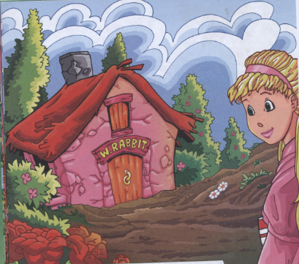
Chapter 6 Alice in the White Rabbit’s House

Slide 3
Guess!!!
It is my friend. It teaches me. It makes me think. It makes me laugh and cry. It shows me the world. What’s this?

Slide 4
Choose the right variant!
1) Who wrote “Alice in Wonderland”?
A. Jack London
B. Mark Twain
C. Charles Lutwidge Dodgson
2) The author’s pseudonym was
A. Lewis Carol
B. Mark Twain
C. James Hadly Chase
3) The novel was written in
A. 1862
B. 1865
C. 1912

Slide 5
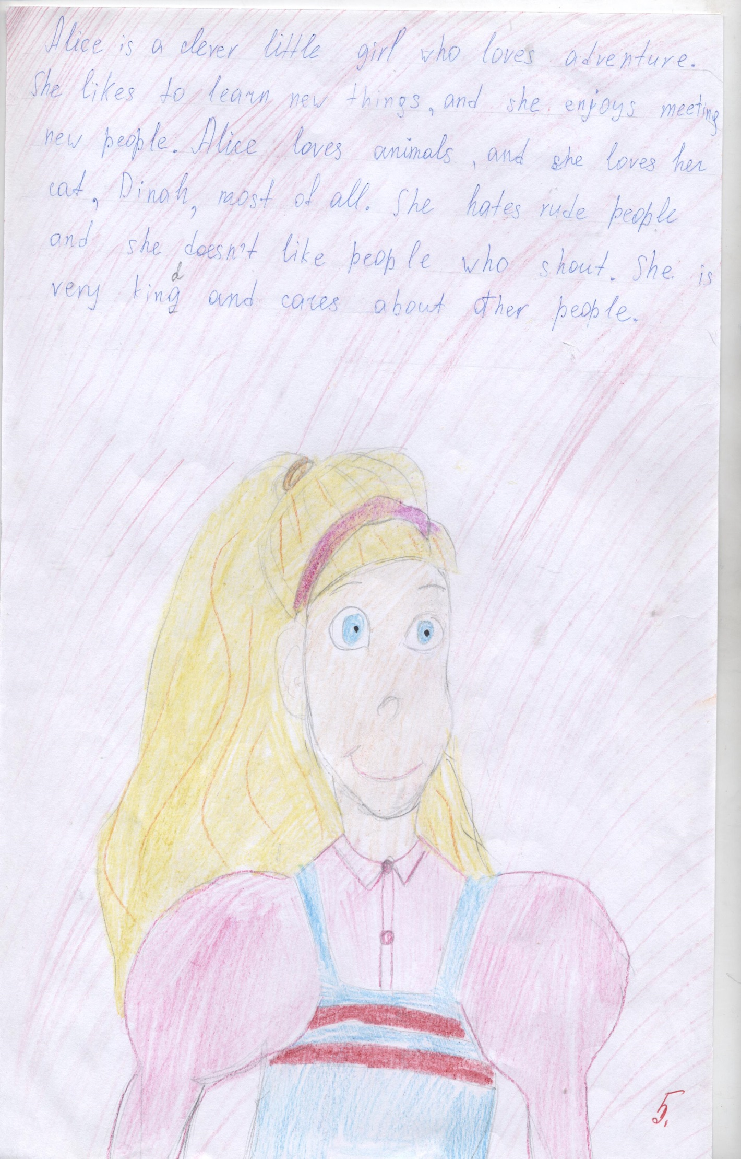

Slide 6
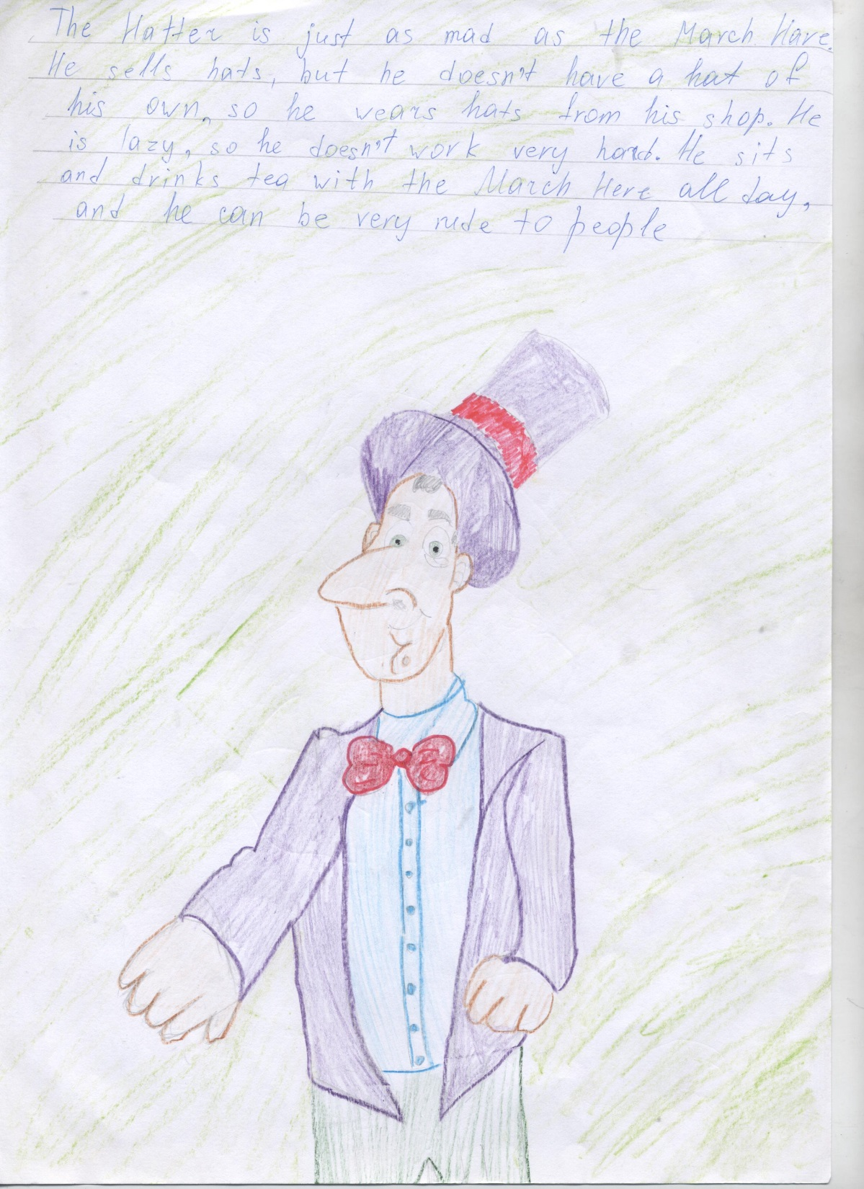

Slide 7
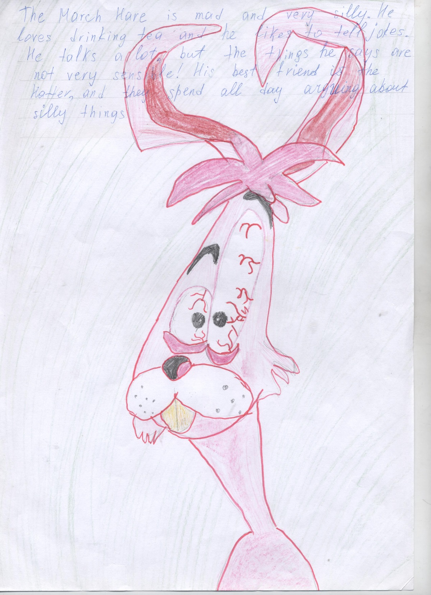

Slide 8
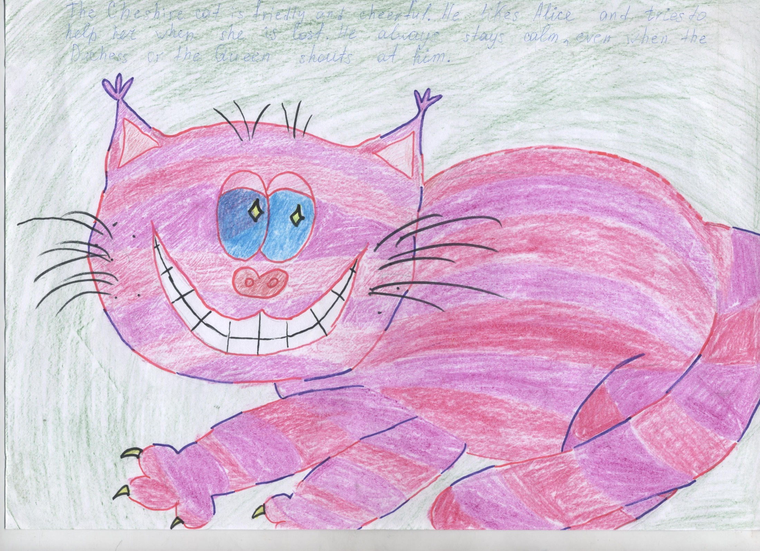

Slide 9
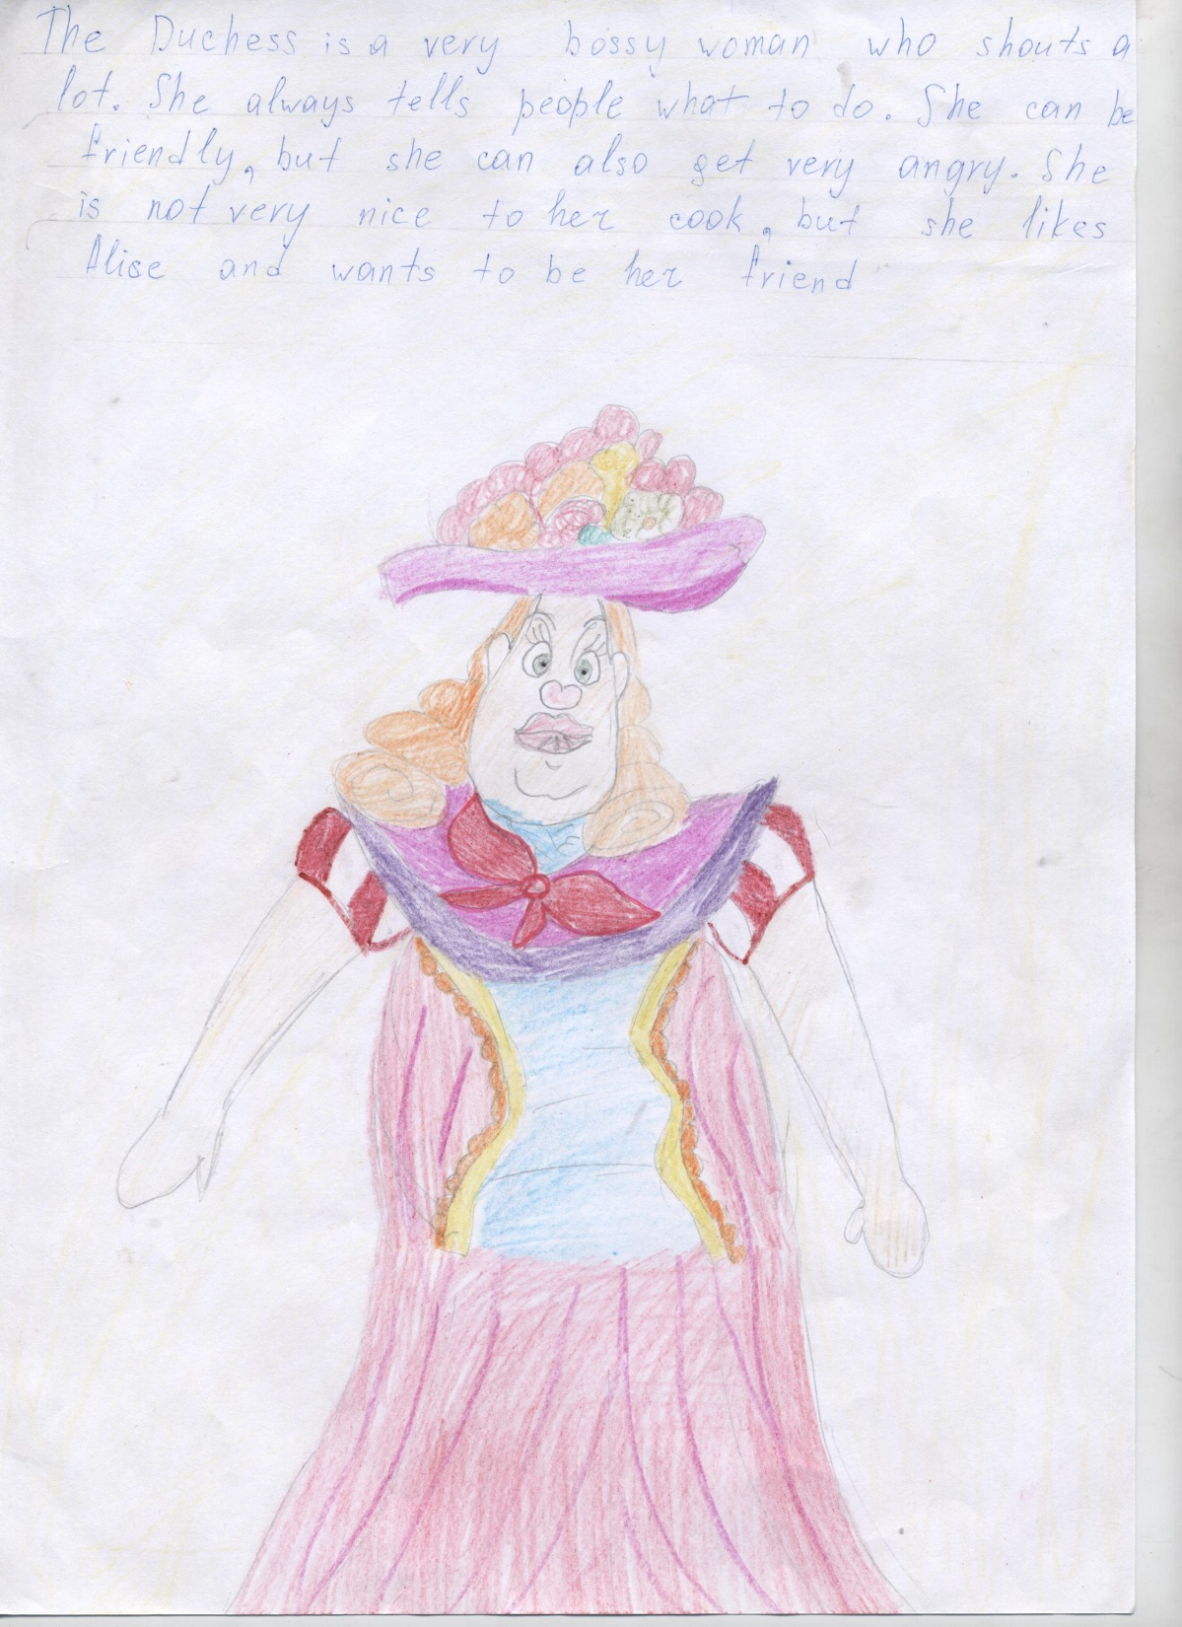

Slide 10
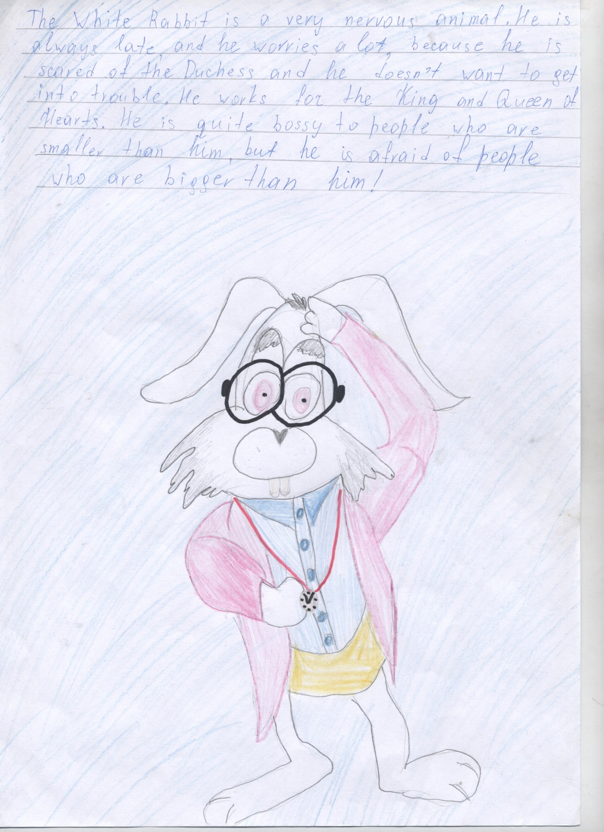

Slide 11
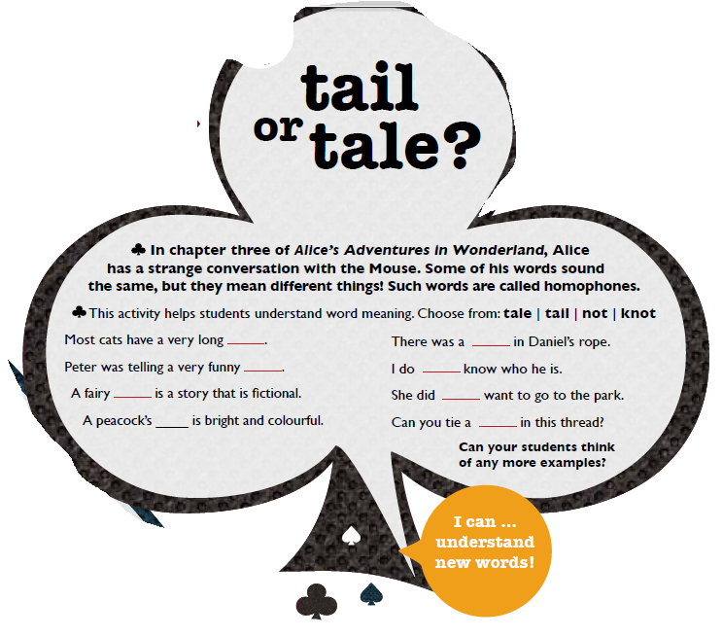

Slide 12
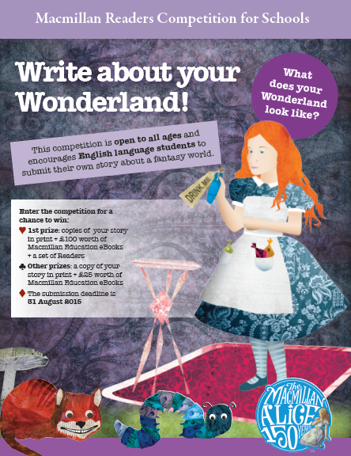

Slide 13
Good luck!

