Slide 1
Муниципальное бюджетное общеобразовательное учреждение «СОШ №9» Ступинского муниципального района.
Работа, представленная на районный конкурс «Учебная презентация».
Номинация: занятие.
В рамках программы по внеурочной деятельности по английскому языку «Клуб Знатоков Британии» по книге Л.Кэрролла «Алиса в стране чудес», 6 класс.
Автор: Белова Наталья Викторовна, учитель английского языка.

Slide 2
Alice in Wonderland by Lewis Carroll

Slide 3
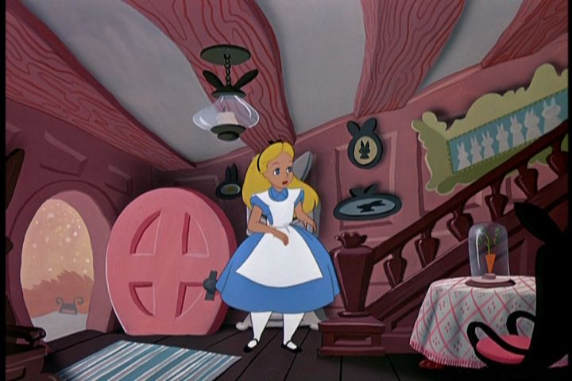
Chapter 6 «Alice in the White Rabbit’s House»

Slide 4
The riddle:
It is my friend. It teaches me. It makes me think. It makes me laugh and cry. It shows me the world.
What’s this?
The answer is «a book»!

Slide 5
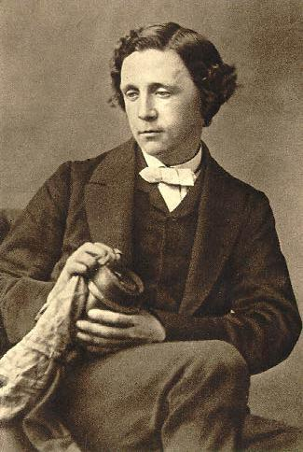
Choose the right variant!
1) Who wrote “Alice in Wonderland”?
A. Jack London
B. Mark Twain
C. Charles Lutwidge Dodgson
2) The author’s pseudonym was
A. Lewis Carol
B. Mark Twain
C. James Hadly Chase
3) The novel was written in
A. 1862
B. 1865
C. 1912

Slide 6
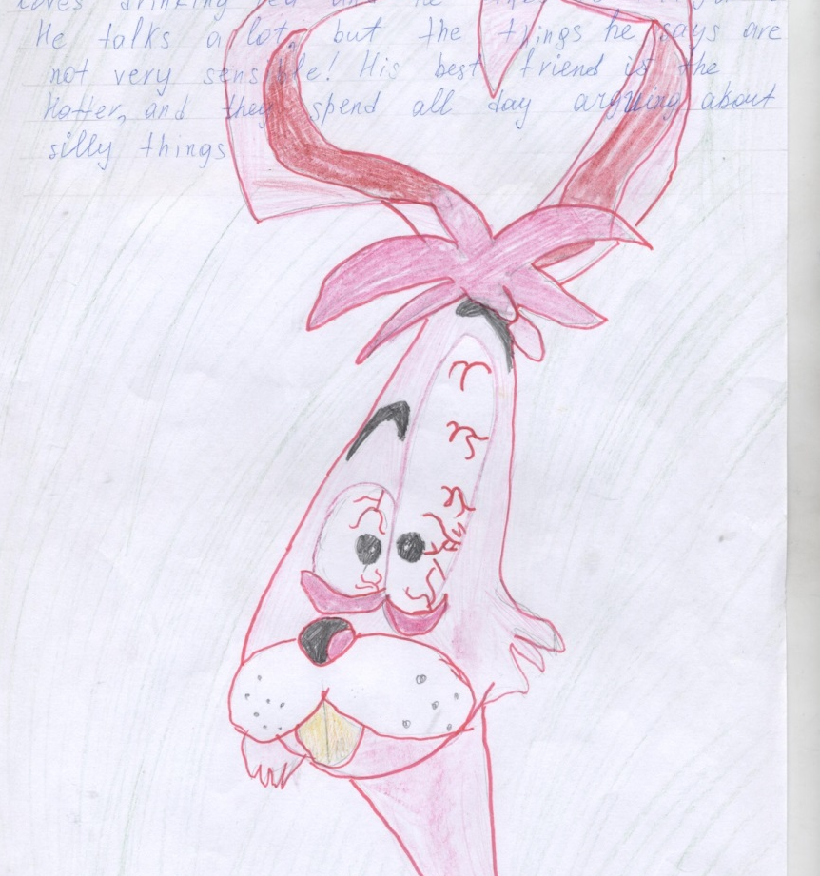
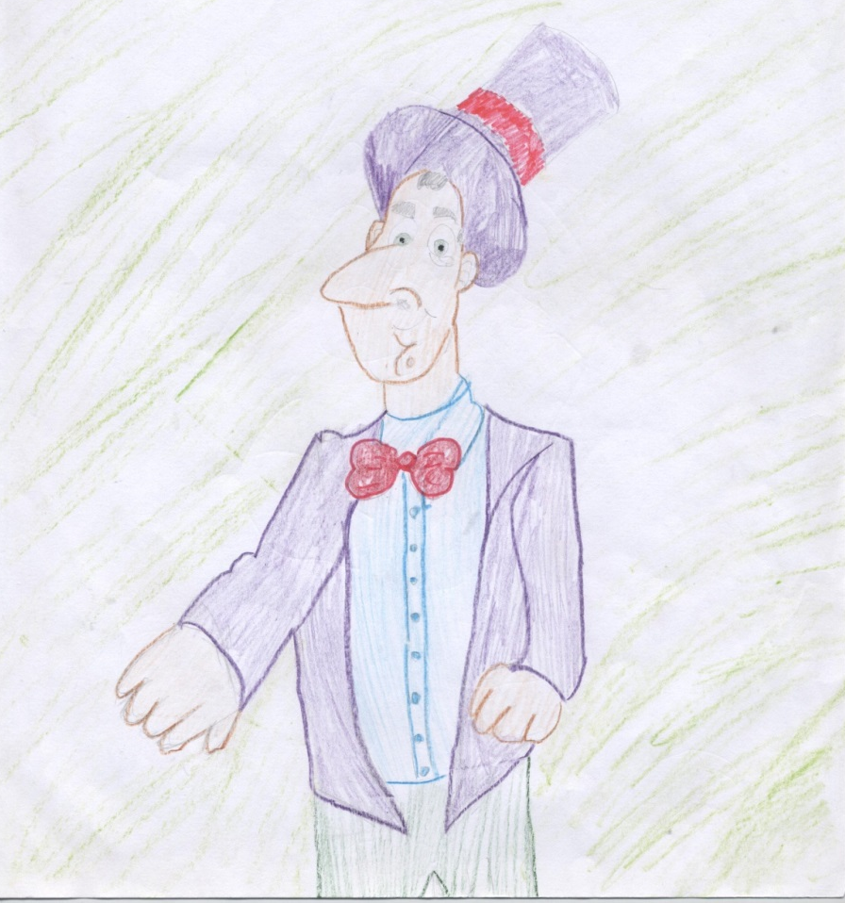
The main characters are
Alice
the March Hare
the Hatter

Slide 7
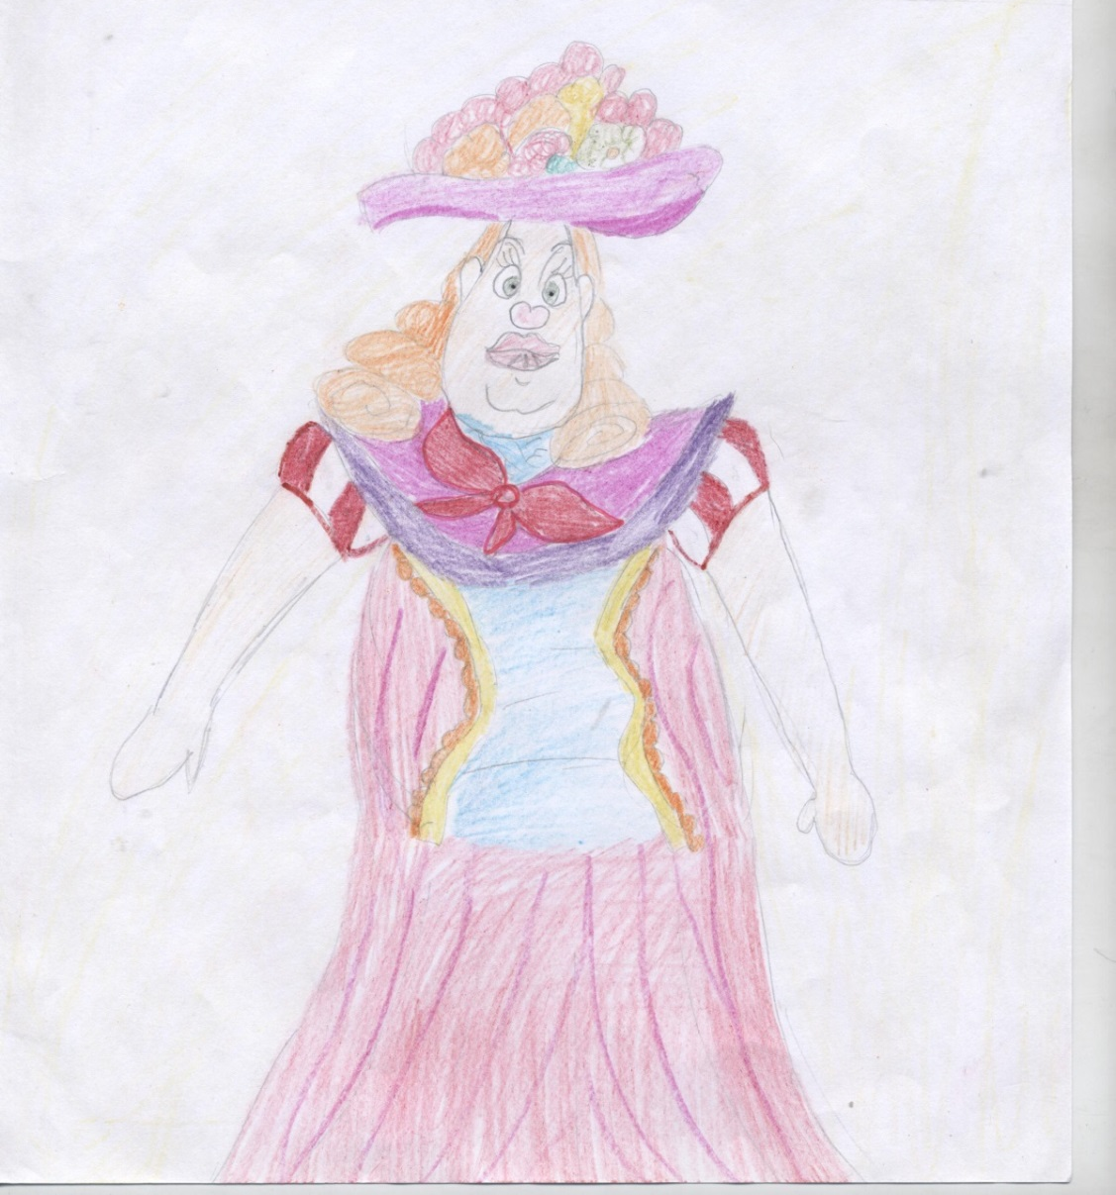
the Cheshire Cat
the Duchess

Slide 8
Look at the screen and make the right choice
The White Rabbit was looking for
Alice
Mary Ann
The fan and the gloves.
2) When Alice came to the White Rabbit’s house, she saw
a little bottle
a little cake
Mary Ann.
3) The White Rabbit and Pat began to
pull Alice by her arm
throw stones through the window
run around the house.
4) Pat was the White Rabbit’s
friend
servant-girl
gardener.

Slide 9
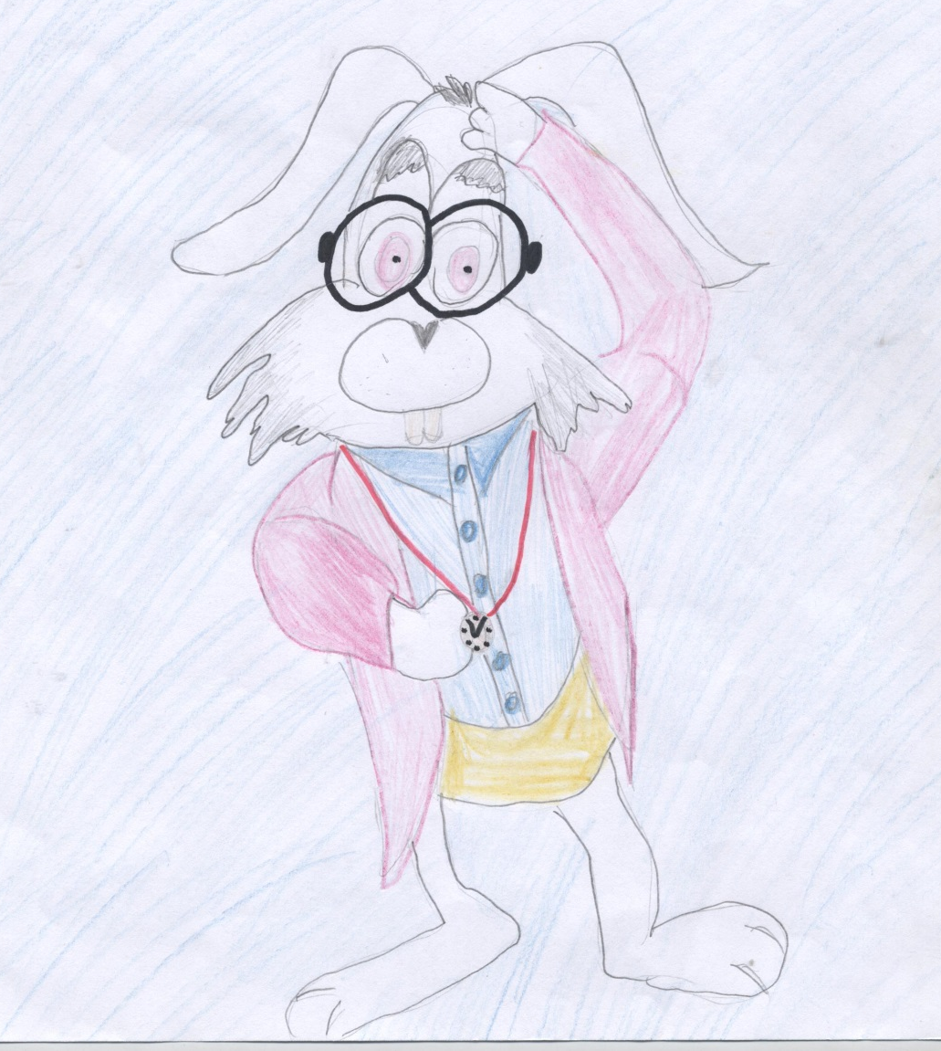
White Rabbit
Who remembers the tongue-twister about the White Rabbit?
[w] [r]
«The White Rabbit ran round Wonderland»

Slide 10
Put the sentences in the right order
1) Alice ran off; after some time she saw a pretty little house.
2) She began to look for the fan and the gloves, but she couldn’ t see them.
3) Alice wanted to grow larger, that is why she put the bottle to her mouth.
4) When the White Rabbit noticed Alice, he ordered her to bring him his gloves.
5) She was ready to go out when she noticed a little bottle near the mirror.
6 )Alice saw the White Rabbit and wanted to help him.
7) She came into the house and took the gloves and the fan.

Slide 11
Complete the sentences
pull
gardener through
rest
bright
catch
sight
«I shall get into the room _____________the window.»
Alice tried to _______________ the Rabbit by the ear.
«Pat is the ____________________,» thought Alice.
Alice thought that the White Rabbit and Pat wanted to _______________ her out of the window.
A __________idea came into her head.
Alice ran off very quickly and soon she was out of _____.
ALICE was very tired and wanted to _________ a little.

Slide 12
Put the verbs in brackets into the correct tense form
1) Alice (begin) to look about her but (can not ) see the gloves.
2) The White Rabbit (say) in an angry tone: «What are you doing here?»
3)Alice (run) as quickly as she (can).
4) She (take) the gloves and the fan and (be) ready to go out.
5) Suddenly she (notice) a bottle that (stand) near the mirror.
6) Alice (open) the bottle and (put) it to her mouth.
7) After a few minutes she (hear) a voice.

Slide 13
tail or
tale?
In chapter three of Alice’s Adventures in Wonderland, Alice has a strange conversation with the Mouse. Some of his words sound the same, but they mean different things! Such words are called homophones.
Choose from
tale|tail not|knot
1) Most cats have a very long ______.
2) Peter was telling a very funny ______.
3) A fairy ______ is a story that is fictional.
4)A peacock’s ______ is bright and colorful.
5) There was a ______ in Daniel’s rope.
6) I do ______ know who he is.
7) She did ______ want to go to the park.
8) Can your tie a ______ in this thread?

Slide 14
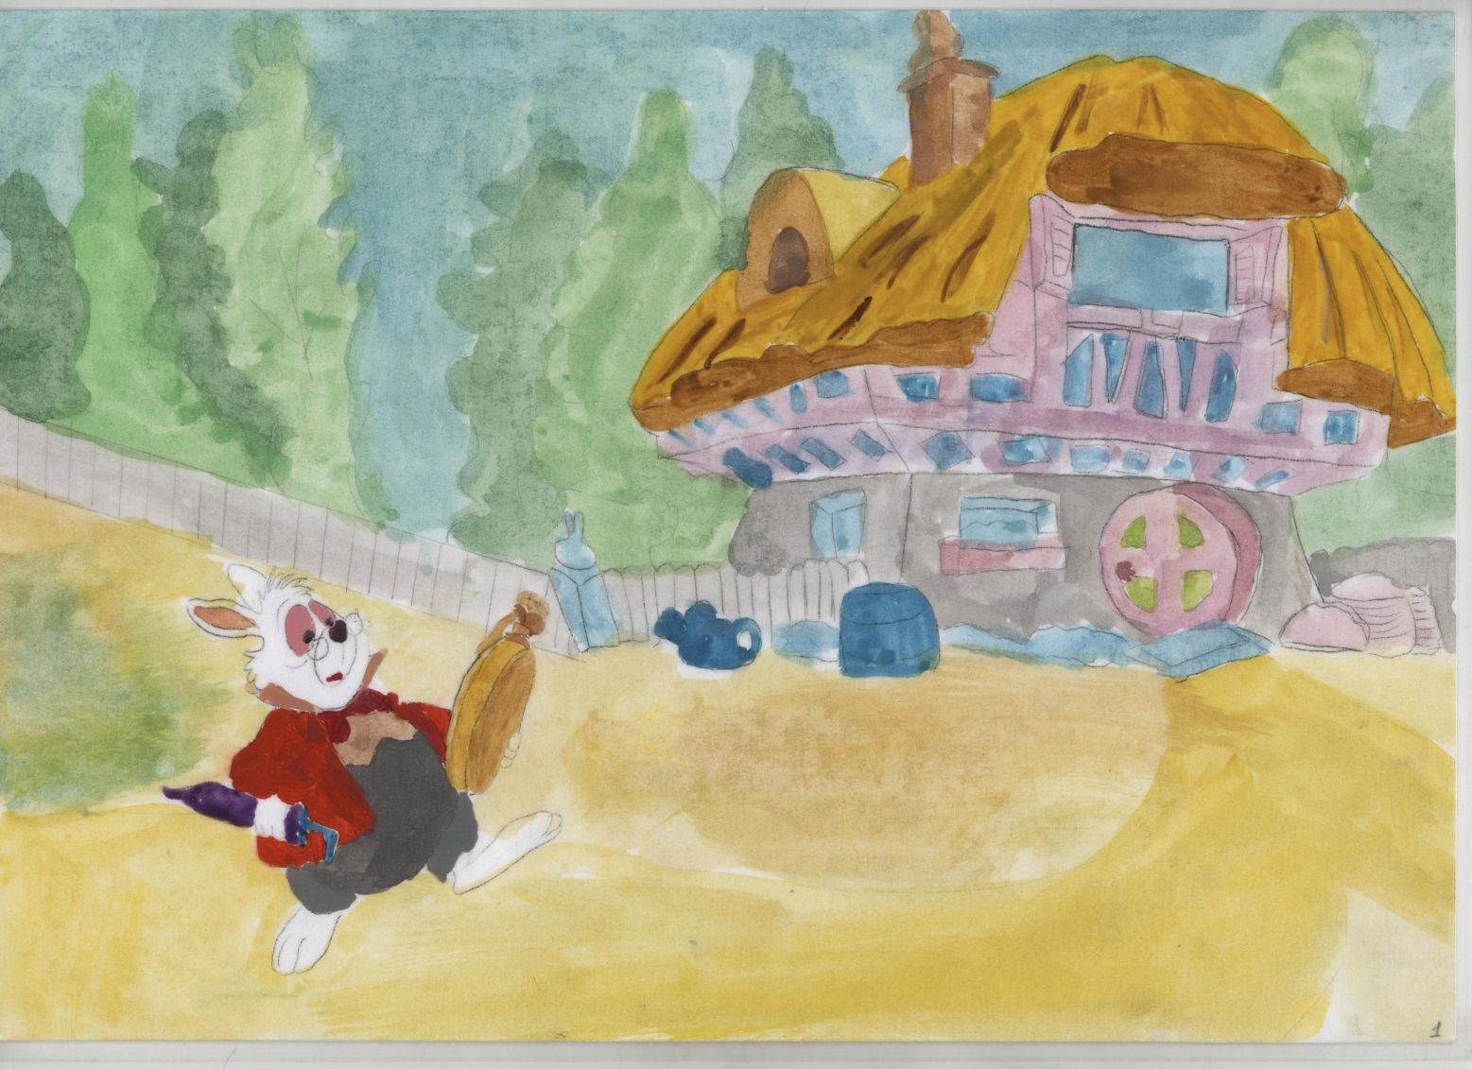
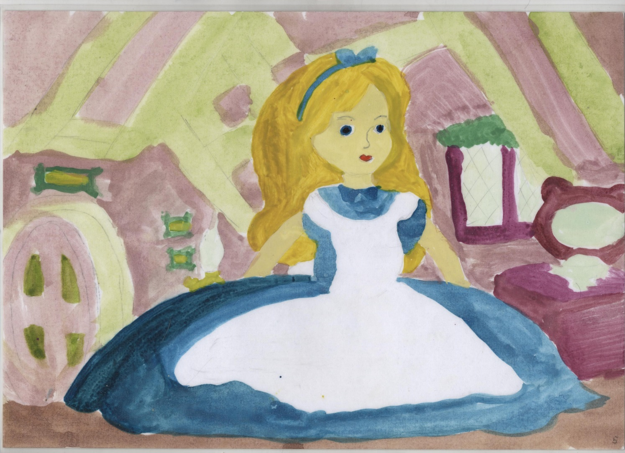
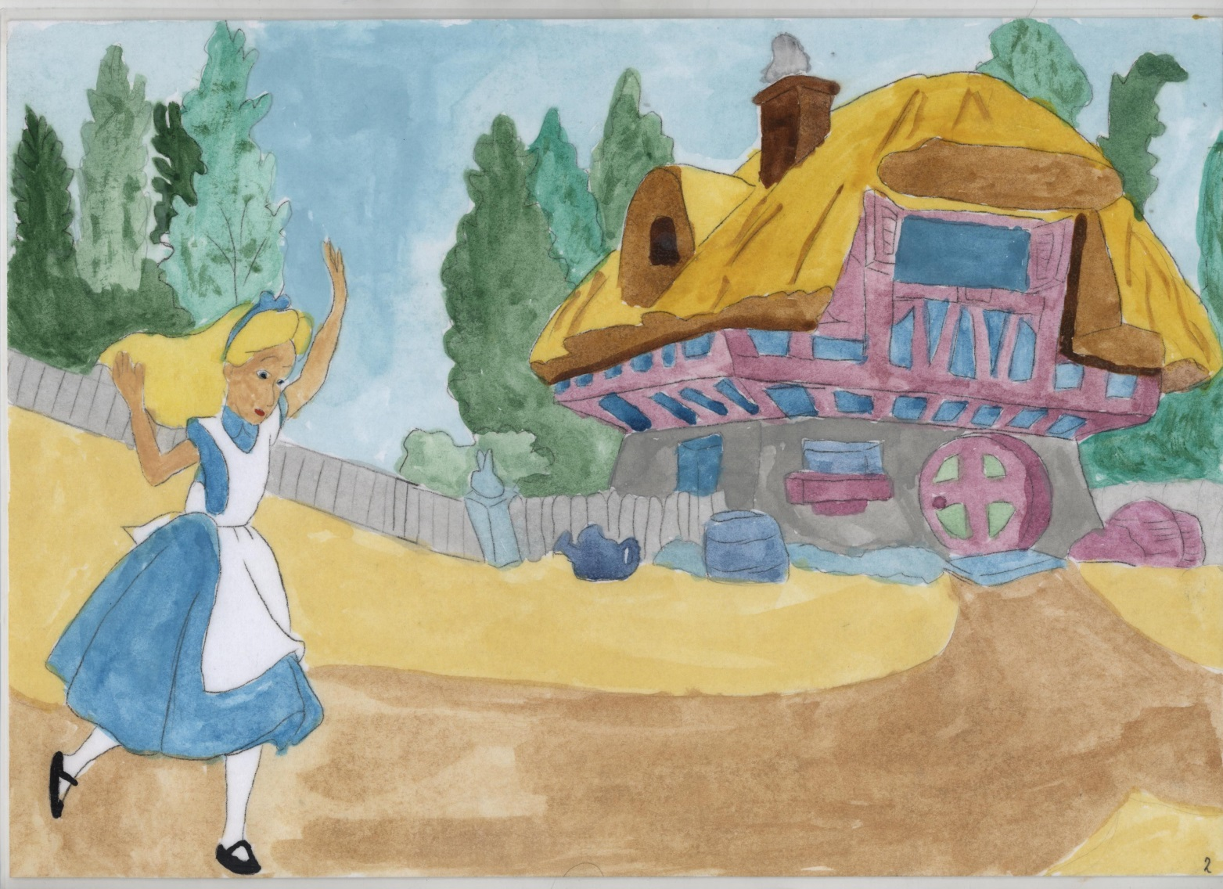
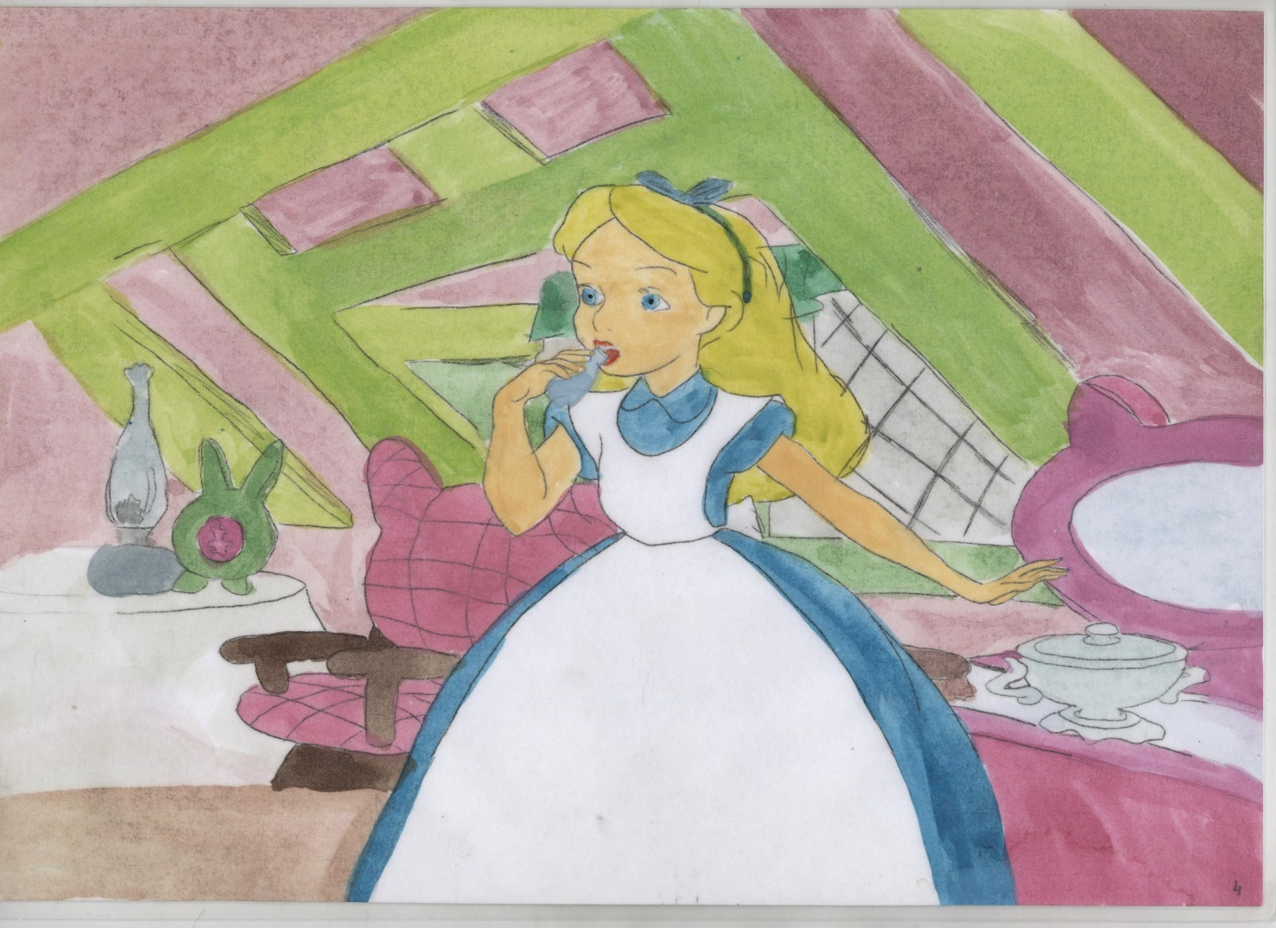
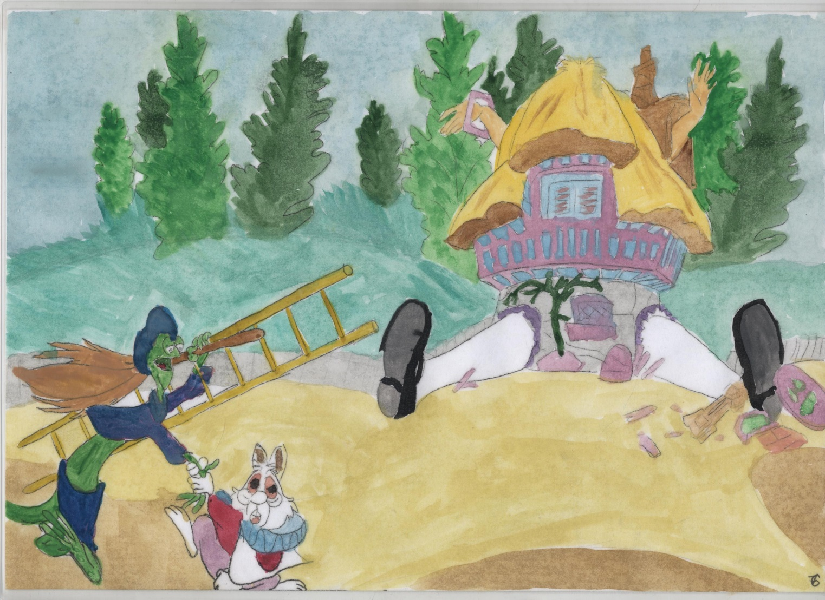
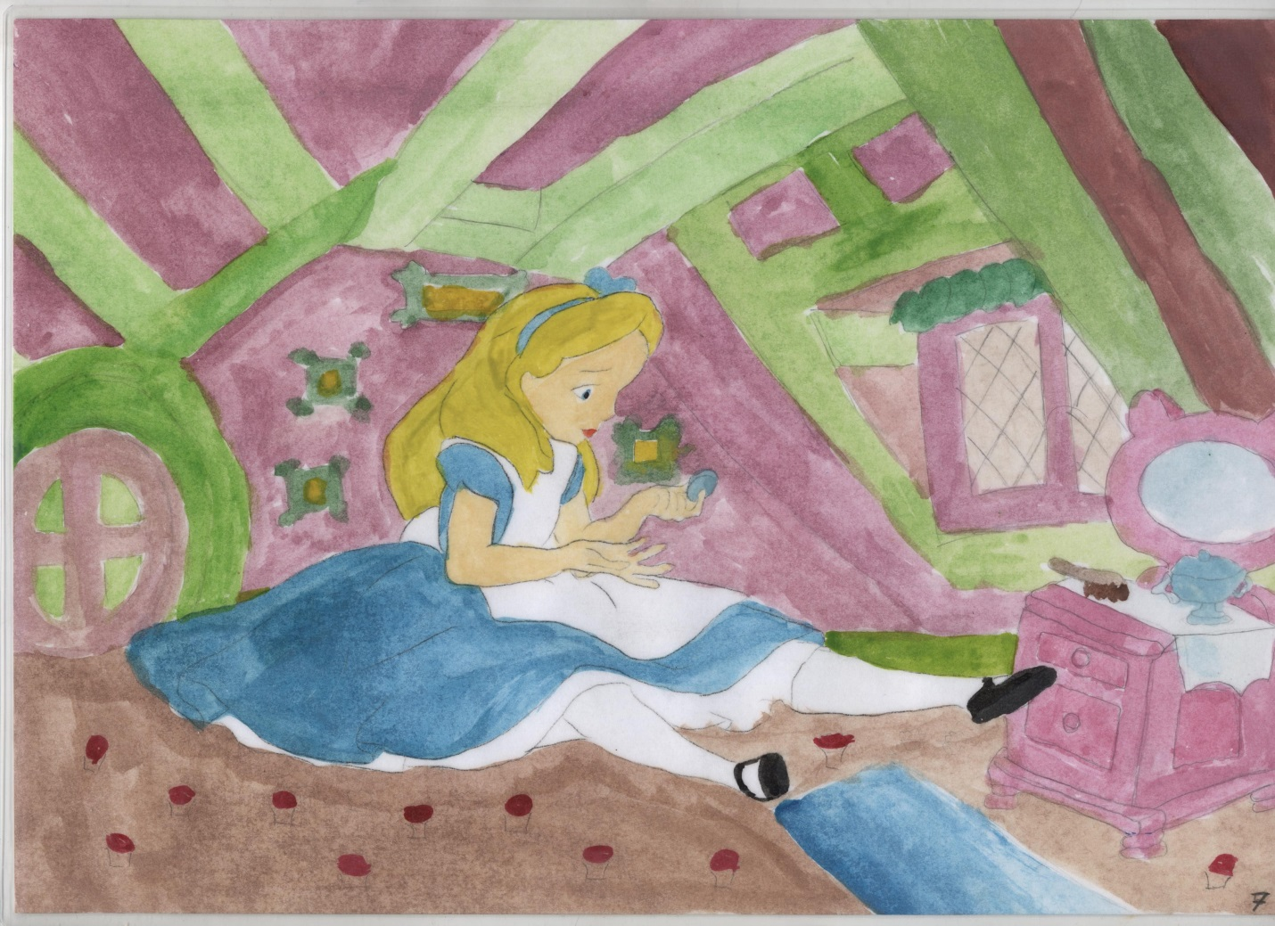
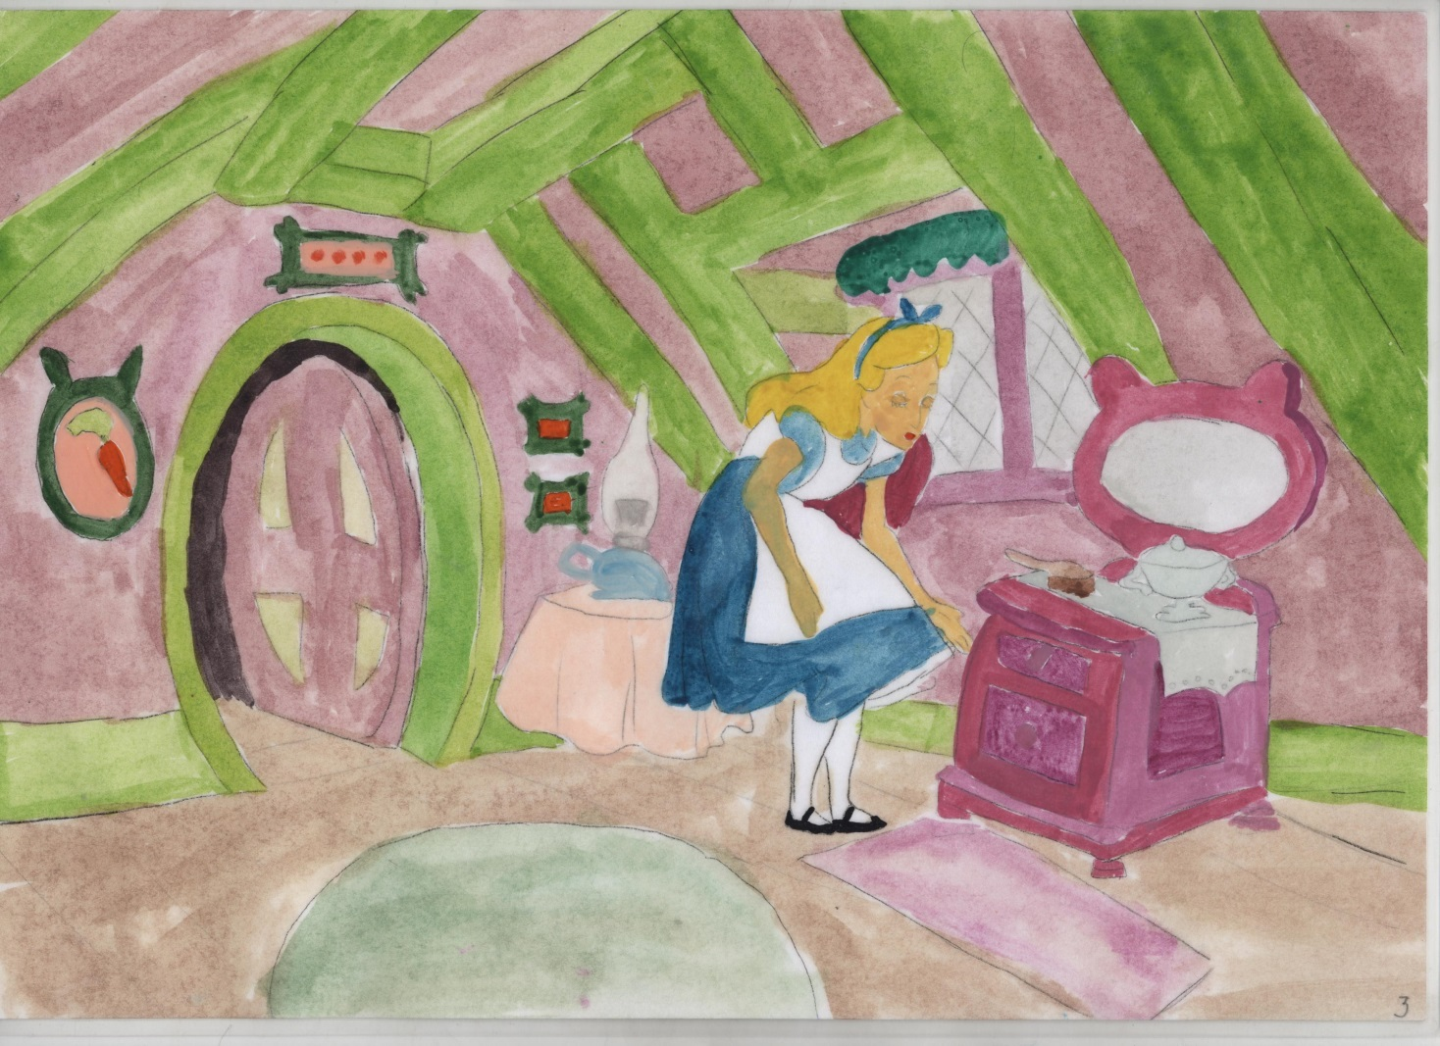
Storytelling

Slide 16
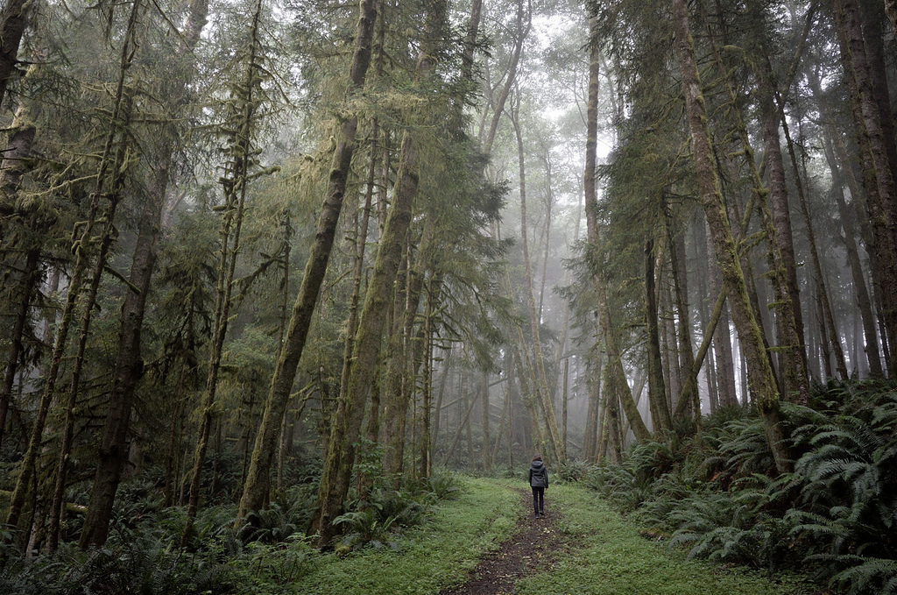
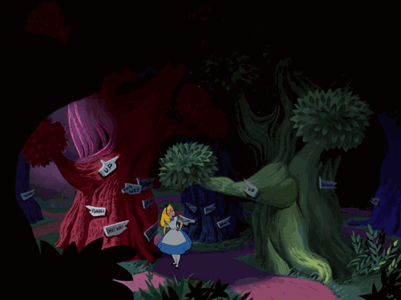
The Wonderful Land
The story about my dreams
by Molchanova Varvara 6 “G” class

Slide 17
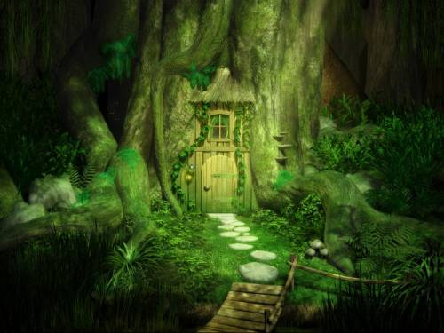

Slide 18
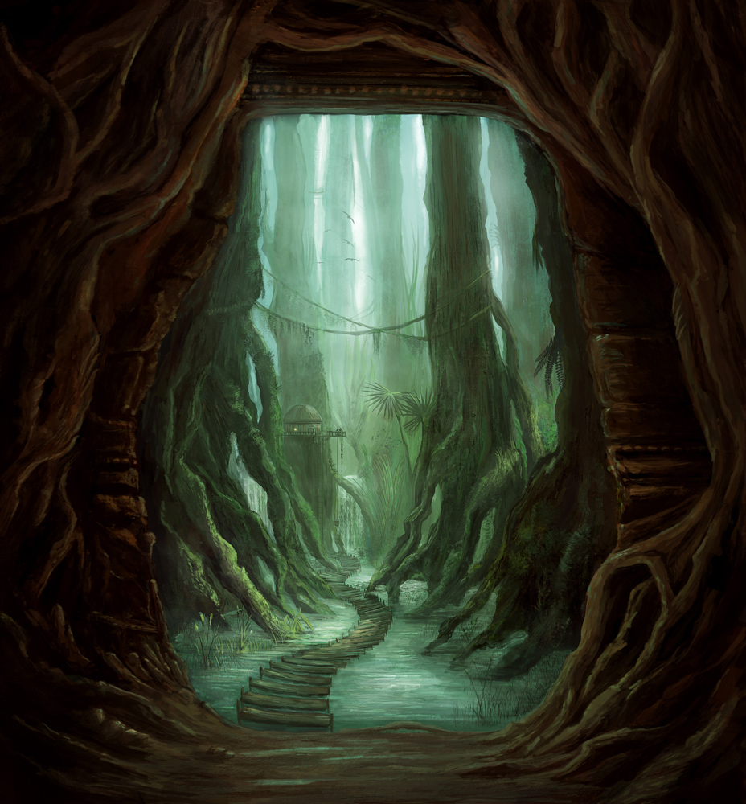

Slide 19
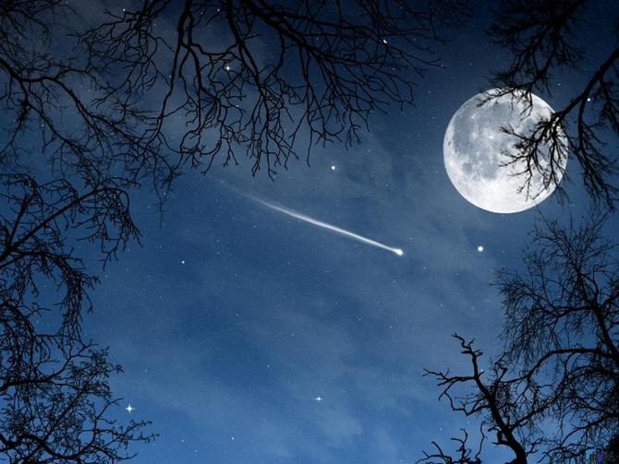

Slide 20
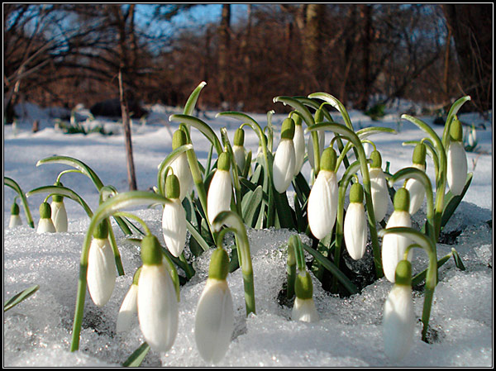

Slide 21
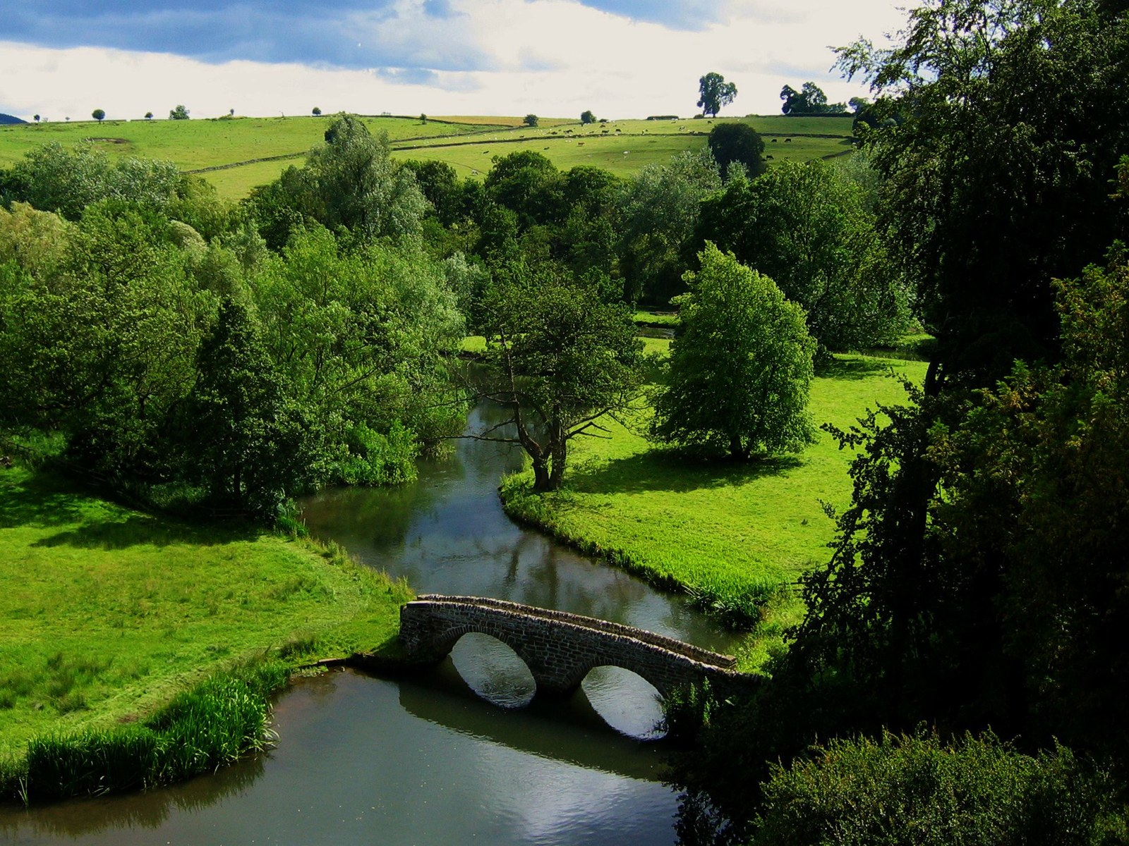

Slide 22
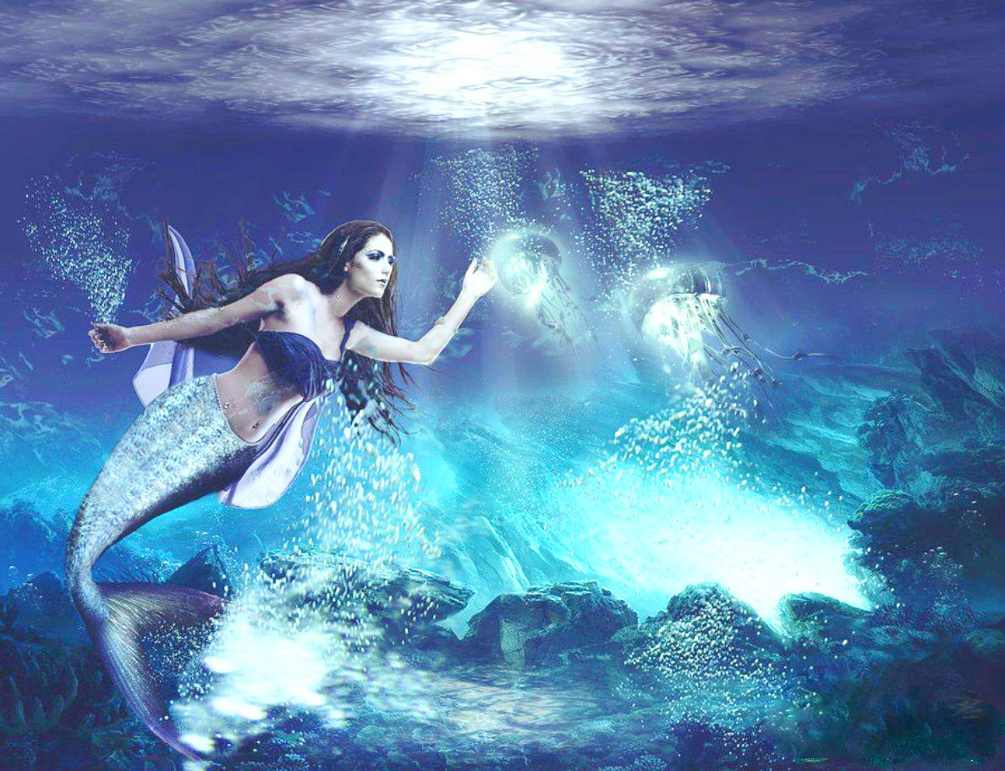

Slide 23
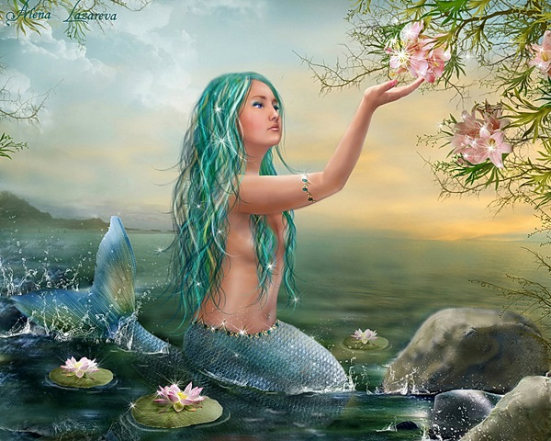

Slide 24
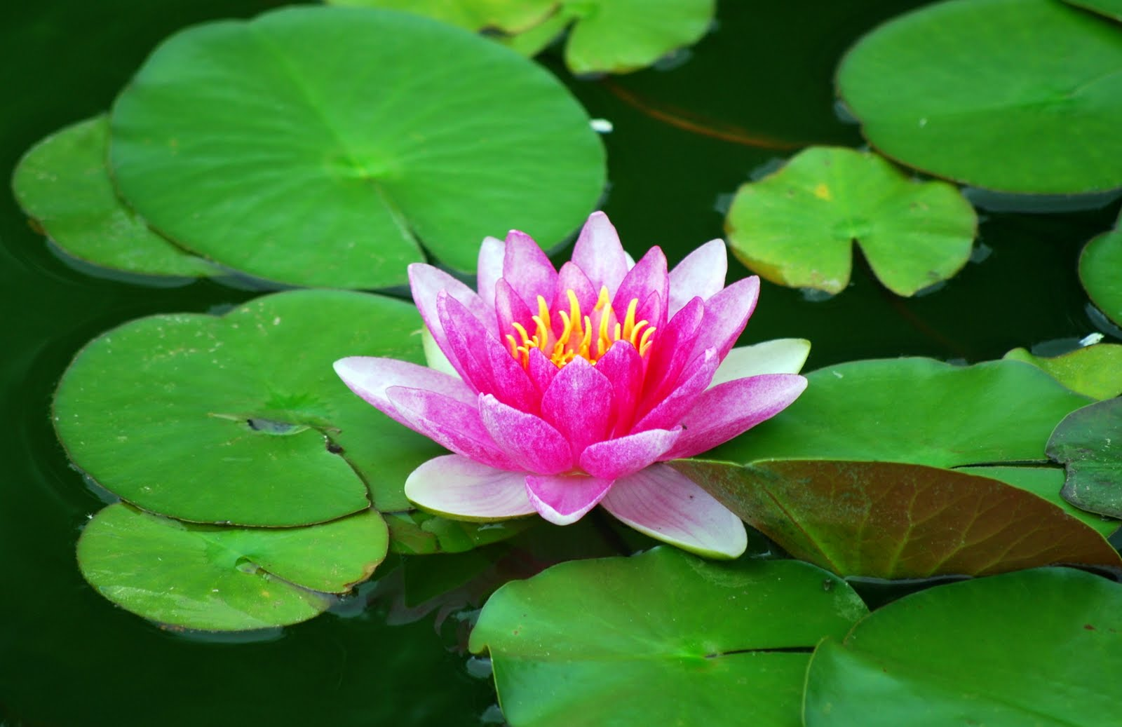

Slide 25
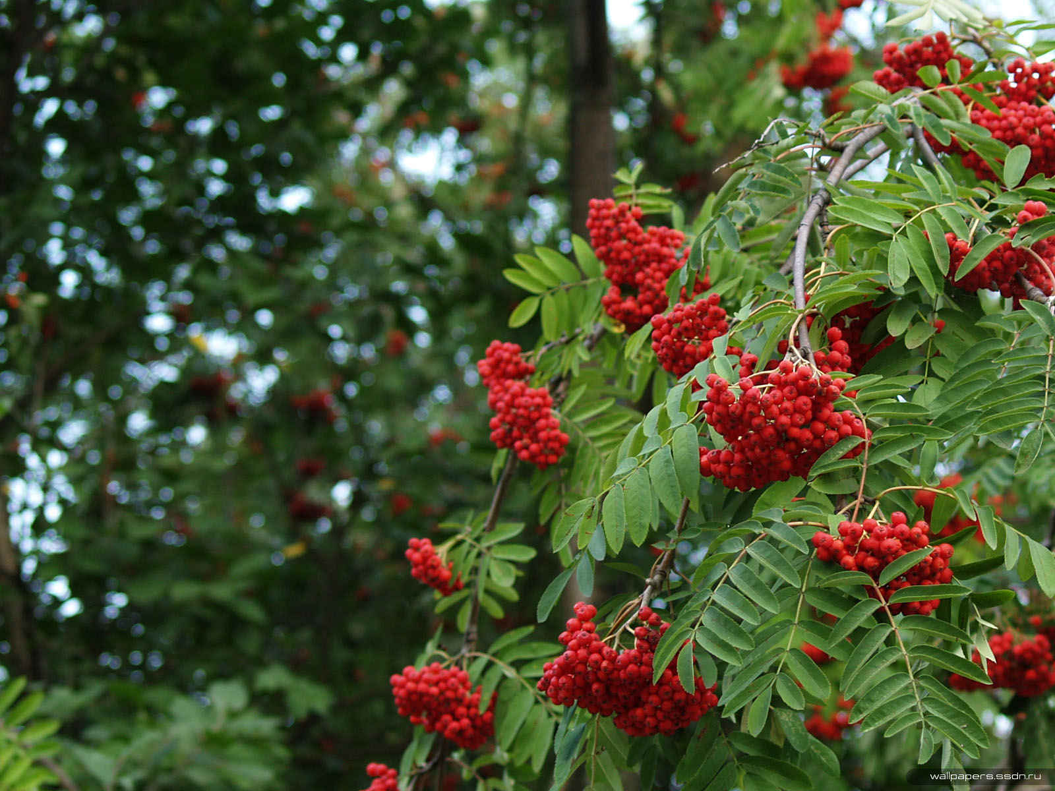

Slide 26
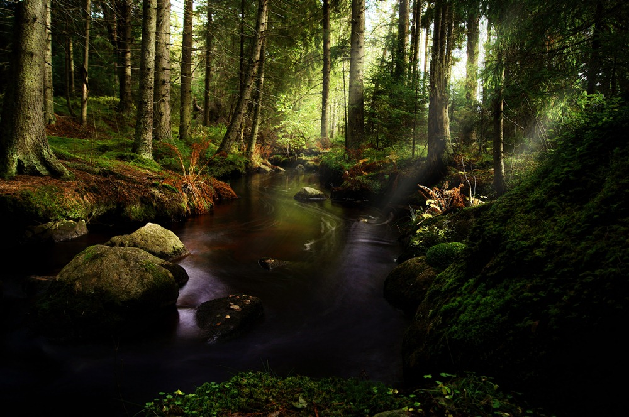

Slide 27
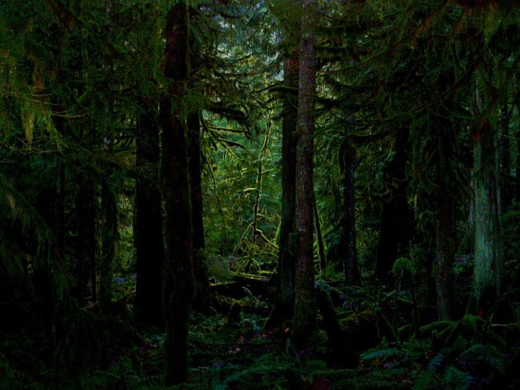

Slide 28
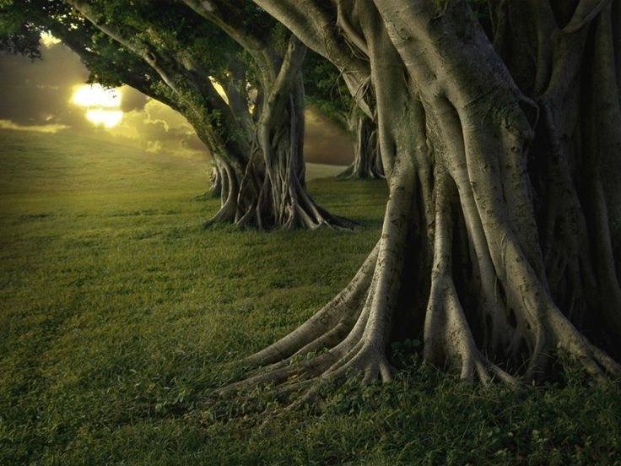

Slide 29
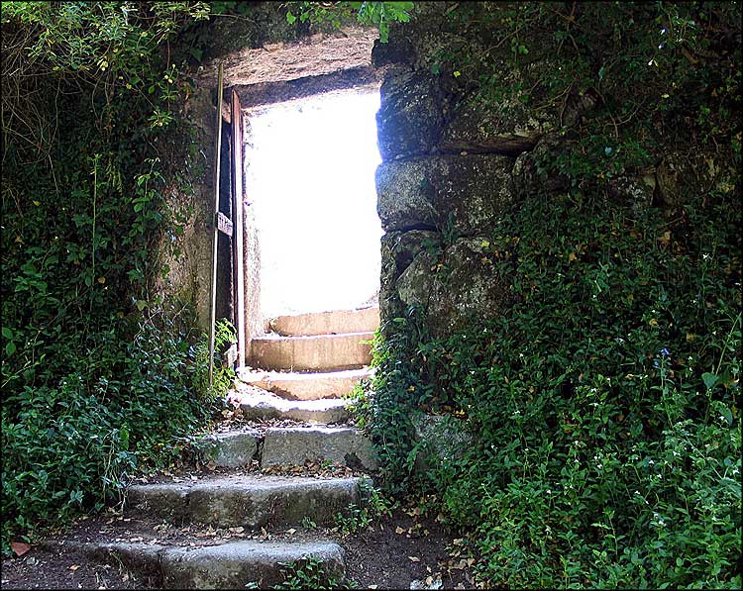

Slide 30
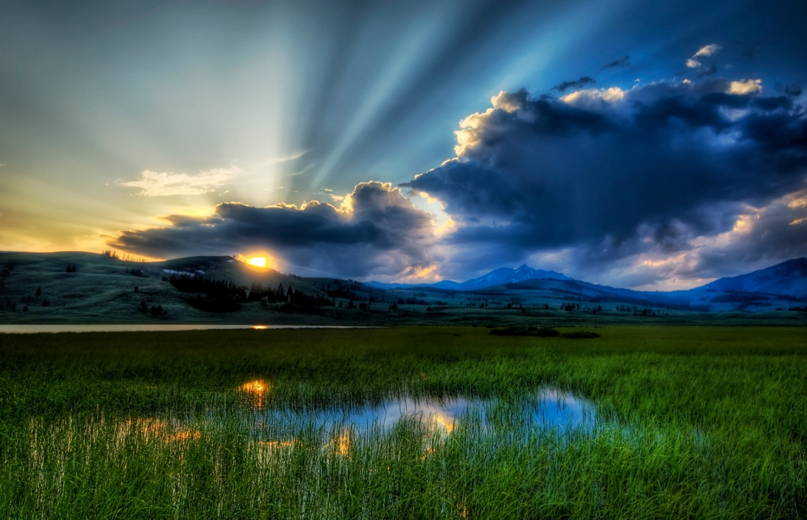

Slide 31
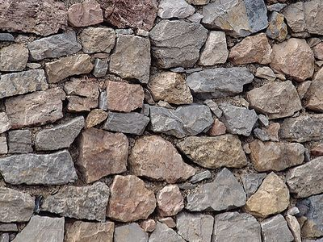
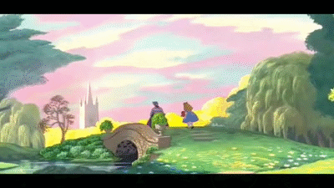
The end.

Slide 32
Список источников основного содержания
Кэрролл Льюис «Алиса в стране чудес», М.: АЙРИС-Пресс, 2015-192с./Английский клуб/ Домашнее чтение.
Скороговорка. Macmillan education // http://www.macmillanenglish.com/teachers-at-the-heart/tea-party-pack/
Tail or tale? Macmillan education // http://www.macmillanreaders.com/wp-content/uploads/2015/01/Alice-activities-poster-CR.pdf

Slide 33
Список источников иллюстраций
Кадр из мультфильма // http://disney.wikia.com/wiki/White_Rabbit's_house.
Кэрролл Льюис «Алиса в стране чудес», М.: АЙРИС-Пресс, 2015-192с./Английский клуб/ Домашнее чтение.
Кэрролл Льюис // http://www.peremeny.ru/blog/4027.
Анонс о конкурсе // http://www.macmillanreaders.com/150-years-of-alice.
Презентация Молчановой Варвары, ученицы 6г класса, на конкурс «Write about your Wonderland».
Автор рисунков: Васина Анна, ученица 6 г класса.
Авторские фотографии.

